Slide 1
Chapter 11 File Paths and Exceptions

Slide 2
File Paths
The are three ways we can include the path to file locations in Python:
functionName(r'D:\data_folder\file_name.dat‘)
functionName('D:\\data_folder\\file_name.dat‘)
functionName('D:/data_folder/file_name.dat‘)

Slide 3
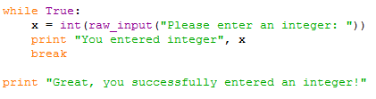
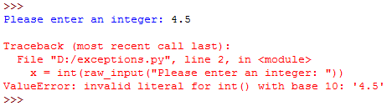
Exceptions
Whenever a runtime error occurs, it creates an exception. Usually, the program stops and Python prints an error message.
The error message has two parts:
the type of error before the colon, and
specifics about the error after the colon
Python’s error message ValueError generally indicates that there is something wrong with the value of a parameter.

Slide 4
Exceptions Cont.
Python also prints a traceback, which identifies the function that is currently running, and then the function that invoked it, and then the function that invoked that function, and so on. It traces the sequence of function calls until the error occurred.
It also includes the line number in your file where each of these calls occurs.

Slide 5
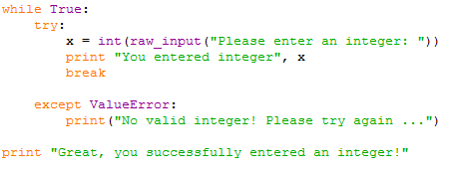
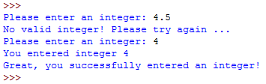
Try and Except Statements
Sometimes we want to execute an operation that could cause an exception, but we don’t want the program to stop.
Exceptions handling in Python is done using the try and except statements.
We include the code that can produce an exception within a try block.
If an error occurs we handle it in the except block and the program does not terminate because of the exception.

Slide 6
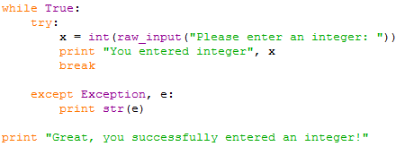
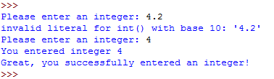
Try and Except Statements Cont.
We can also print the Python error message:

